Slide 1
Lesson 5
The Object Oriented Paradigm
and UML:
One Unified Field Appearing As
Infinite Diversity

Slide 2
Objectives: Fundamentals of OO and UML
Understand fundamental concepts that underlie OOAD
Understand syntax and semantics of UML class diagrams
Be able to translate UML class diagrams to code and reconstruct UML diagrams from code
Understand inheritance, interfaces, packages
Understand polymorphism
  how works
  why valuable
Notes:
ID Course Overview

Slide 3
Topics: Fundamentals of OO and UML
Principles of the OO Paradigm
UML class diagrams
  design elements
  relationships
Notes:
ID Course Overview

Slide 4
Principles of the Object Oriented Paradigm
Encapsulation:
A property of classes whereby the data for which one class is responsible may be read and/or processed by other objects only to the extent allowed by the interface of public methods provided by the class.
Polymorphism:
A property of types whereby a reference variable of one type may refer to objects of any subtype.
Inheritance:
A property of classes whereby methods and fields of one class (the superclass) are accessible to another class (a subclass) without the use of an explicit
reference to the superclass.
Notes:
ID Course Overview
See polymorphism demo

Slide 5
Encapsulation
Encapsulation
The implementation is hidden behind an interface, and clients only depend on the interface.
client
implementation
client
interface

Slide 6


Inheritance
Inheritance
Different levels of abstraction
Vehicle
MotorVehicle
HorseDrawnVehicle
Car
Truck
HorseCart
TrailCart
Notes:
ID Course Overview
Draw class diagram for clarity

Slide 7
Polymorphism
Polymorphism
A property of types whereby a reference variable of one type may refer to objects of any subtype
These classes inherit from the class Account:
SavingsAccount:
getCurrentBalance()
[computes current
balance plus stable rate
interest and returns]
CheckingAccount:
getCurrentBalance()
[computes balance by deducting
fee if below min balance and returns]
MoneyMarketAcct:
getCurrentBalance()
[computes current balance plus
variable rate Interest and returns]
//SAMPLE
Account[] accounts = new Accounts[3];
accounts[0] = new SavingsAccount();
accounts[1] = new CheckingAccount();
accounts[2] = new MoneyMarketAcct();
double totalBalance = 0.00;
for(Account a : accounts)
totalBalance += a.getCurrentBalance();
Notes:
ID Course Overview
Ignore and use your own example

Slide 8
Topics: Fundamentals of OO and UML
Principles of the OO Paradigm
UML class diagrams
  design elements
  relationships

Slide 9
UML Diagrams
The two most commonly used UML diagrams are sequence diagrams and class diagrams.
A sequence diagram shows the flow of the application by representing a scenario (sometimes several) as a sequence of messages passed from one runtime object to another
A class diagram shows the static relationships between classes, and shows in more detail the attributes and operations of each class

Slide 10
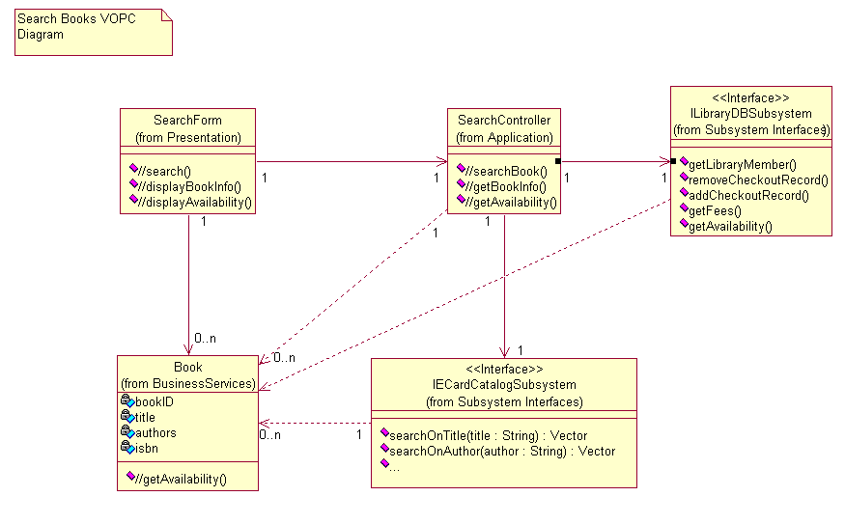
UML Class Diagram
Fundamental to understand structure and architecture of an OO system

Slide 11
Topics: Fundamentals of OO and UML
Principles of the OO Pardigm
UML class diagrams
  design elements
  relationships

Slide 12
UML Class Diagrams
UML Class Diagram
design elements
class
abstract class
interface
package
subsystem
attributes
operations
UML Class Diagram relationships
association
aggregation
composition
dependency
inheritance

Slide 13
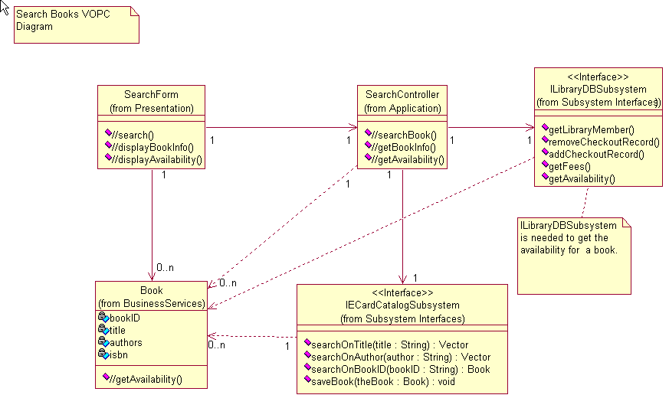
UML Class Diagrams
UML adornments
  notes
  stereotypes (descriptor delimited by two guillemets << -- >>)
Stereotypes
Notes

Slide 14
Package
A package is a general purpose mechanism for organizing elements into groups
Accounting
Human
Resource
Sales

Slide 15
Subsystem
Special type of package.
A subsystem has both package and class characteristics
- contains other model elements
- has interface and behavior
<<subsystem>>
Accounting
IAccounting
B420-22

Slide 16
Topics: Fundamentals of OO and UML
Principles of the OO Paradigm
UML class diagrams
  design elements
  relationships

Slide 17
Relationships
Association
- Aggregation & Composition
Dependency
Inheritance
Realization

Slide 18
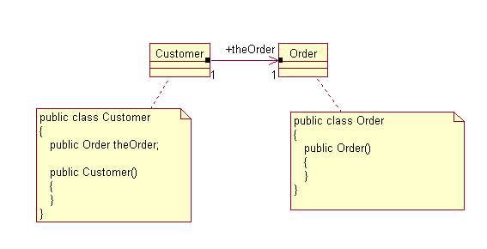
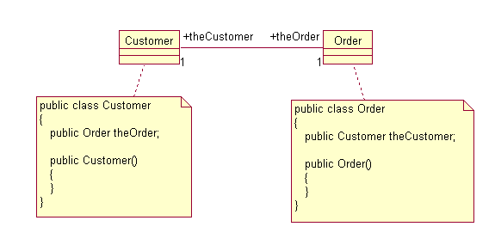
Association
Uni-directional
Association Role
Bi-directional

Slide 19
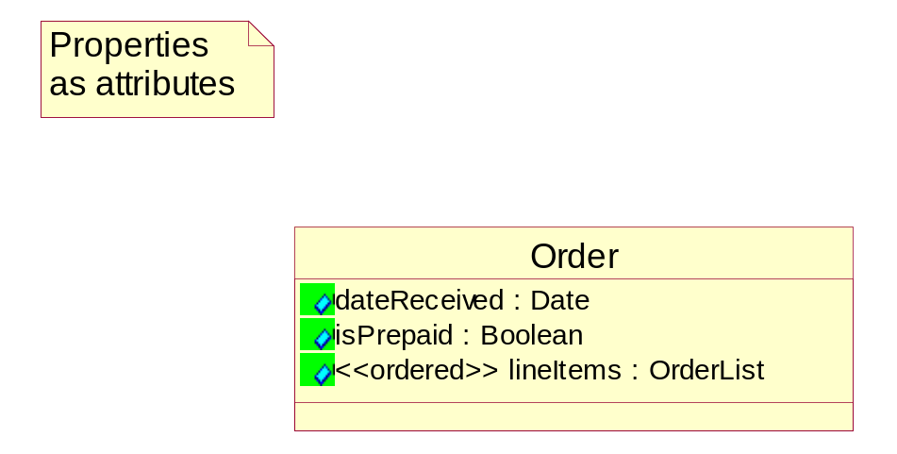
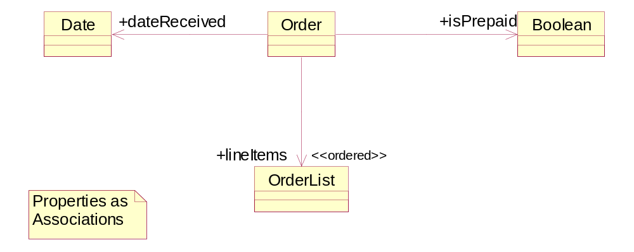
Representing Properties As Associations

Slide 20
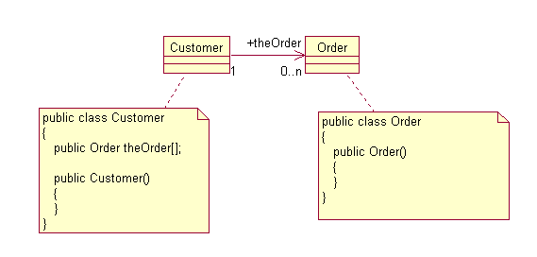
Multiplicities of an Association
Multiplicity
1 one
3 three
n many
0..n zero or more
1..n one or more
0..1 zero or one
Determining Multiplicities:
How many objects
(instances) of the class can
be associated with one
instance of the other class.

Slide 21
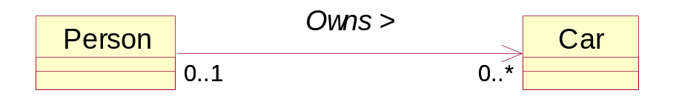
Association
An association may have a name.
An association name should
always be a verb.
The direction of the relationship
can be specified with a little arrow

Slide 22
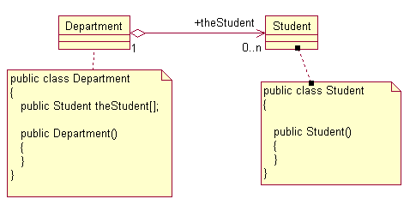
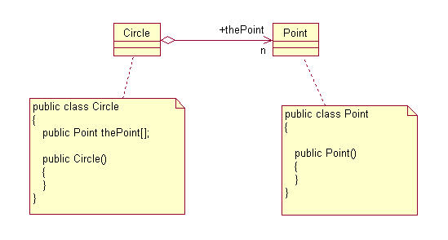
Aggregation
Specialized form of association
whole - part relationship

Slide 23

Composition
Strong type of aggregation
Rule: The class diagram may show multiple classes of potential owners, but any instance has only a single object as its owner -- so there are no shared instances (by contrast, think of singleton classes)
Another criterion: When the whole (or owner) is destroyed, the part is also destroyed
Multiplicities: Only possible value associated with owning class is 1.
Exercises: Are the following relationships aggregation or composition? Club to ClubMember, Circle to Point, Company to Department

Slide 24
Dependency
The client class has a dependency relationship with the supplier class if a change in the supplier class may cause a change in the client class. If you want to re-use the class Client, you must also include Supplier because of the dependency relationship. Sometimes indicates a uses relationship.
Example: If one of the public methods of the Supplier class is taken out, the Client cannot access Supplier in the same way.
Client
Uses
Supplier

Slide 25
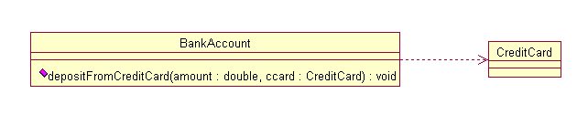
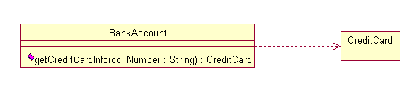
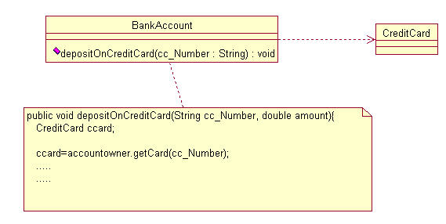
Dependency Examples
BankAccount has a method with a parameter of type CreditCard
BankAccount has a method with a return value of type CreditCard
BankAccount has a method with a local variable of type CreditCard

Slide 26
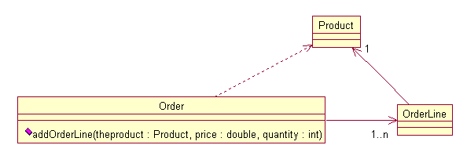
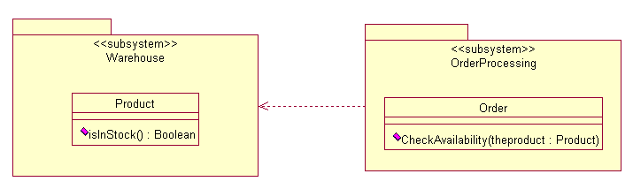
Dependency Examples

Slide 27
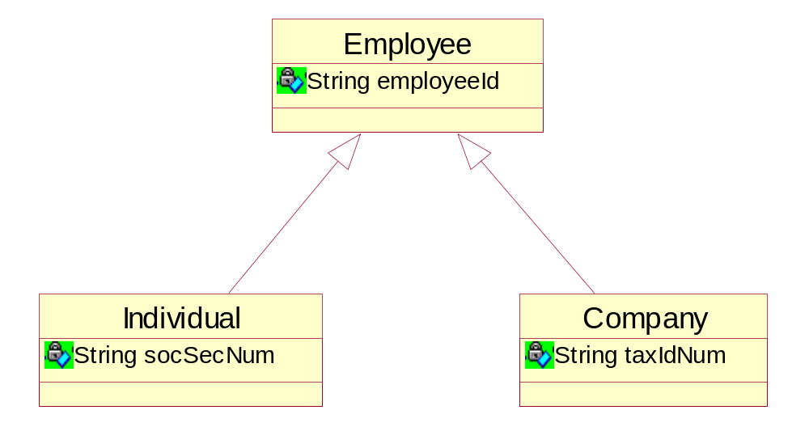
Inheritance: ISA Relationship
Represents a relationship between a general (super class
or base class) and a specific class (subclass or derived class)
Notes:
ID Course Overview
See alternative way of modeling, using Profile as a superclass.

Slide 28
Polymorphism Again
Polymorphism = many forms
References of a particular type can point to many
different actual (sub) types
Implemented with dynamic binding (late binding)
Dynamic binding:
A
When B and C are subclasses of A and A has a method m(), the method name m is bound at runtime to the correct method body (belonging to an instance of either A, B, or C).
B
C
Notes:
ID Course Overview
Wait a couple more slides for my example
See note about dynamic binding

Slide 29
Polymorphic Type Assignment
class Student {…}
class Undergraduate extends Student {…}
class Graduate extends Student {…}
Student st1,st2, st3;
Graduate st4;
st1 = new Student(); // okay
st2 = new Undergraduate(); // okay
st3 = new Graduate(); // okay
st2 = new Graduate(); // okay
st4 = new Student(); // compilation error
Student
Undergraduate
Graduate
Notes:
ID Course Overview
skip

Slide 30
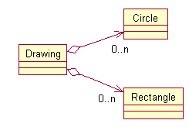
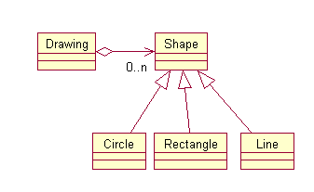
Why Polymorphism?
Polymorphism makes your code more flexible.
Without polymorphism: A Drawing can only contain Circles and Rectangles. The Drawing class needs to be modified when a new shape needs to be added.
With polymorphism: Drawing consists of Shapes, and new shapes can be added without modifying the Drawing class.
Notes:
ID Course Overview
This is enough like my example to go over – do example here

Slide 31
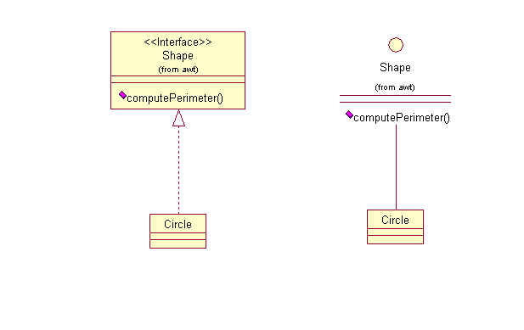
Interfaces In UML
An interface may be represented using the <<interface>> stereotype and the “realizes” arrow, or with "lollipop" notation.
Interfaces are also used to support polymorphism:
  Shape[] shapes = new Shape[2];
  shapes[0] = new Circle(); //assume Circle implements Shape
  shapes[1] = new Square(); //assume Square implements Shape
  double perimeterSum = 0.0;
  for(Shape s : shapes)
  perimeterSum += s.computerPerimeter();
  averagePerimeter = perimeterSum / shapes.length;
Notes:
ID Course Overview
A stereotype in UML is a way of classifying or qualifying a design element. Just one per element

Slide 32
Module Summary
1. Key OO concepts include abstraction, encapsulation, modularity, inheritance, high cohesion, low coupling
2. UML class diagrams show structural relationships between design elements
K13-14
Notes:
ID Course Overview
Cohesion – indicates all parts work together for a single purpose

Slide 33
Summary: UML Class Diagrams
UML Class design elements
class
operation
attribute
interface
package
subsystem
Other UML design elements
object
component
UML Class relationships (not considered to be design elements)
association
aggregation
composition
dependency
inheritance
realization

Slide 34
Review Questions
What are the three fundamental principles of object orientation?
Name four design elements that can appear on a class diagram (relationships don't count)
Name four relationships that can appear on a class diagram
What is the purpose of UML stereotypes?
K13-14
Notes:
ID Course Overview
Encapsulation, hierarchy, polymorphism
Internal cohesion – parts are related to each other and work together for a common purpose
Low external coupling – high coupling makes more rigid, harder to change one thing without changing others. If
high coupling is happening it often suggests the existence of a subsystem
Four design elements: class, interface, operation, attribute
Four relationships: dependency, association, aggregation, composition
Stereotypes are used to classify elements – can be used with classes, objects, methods – any design element

